Slide 1

Lesson 6: TRIGONOMETRIC IDENTITIES
Math 12
Plane and Spherical Trigonometry
Notes:
Week 5

Slide 2
OBJECTIVES
At the end of the lesson the students are expected to:
Review basic identities.
Simplify a trigonometric expression using identities.
Verify a trigonometric identity.
Apply the sum and difference identities.
Apply the double-angle and half-angle identities.
Apply the product-to-sum and sum-to-product identities.
Notes:
Week 5

Slide 3

TRIGONOMETRIC IDENTITIES
A trigonometric identity is an equation involving trigonometric functions that hold for all values of the argument, typically chosen to be $θ$.
Notes:
Week 5

Slide 4
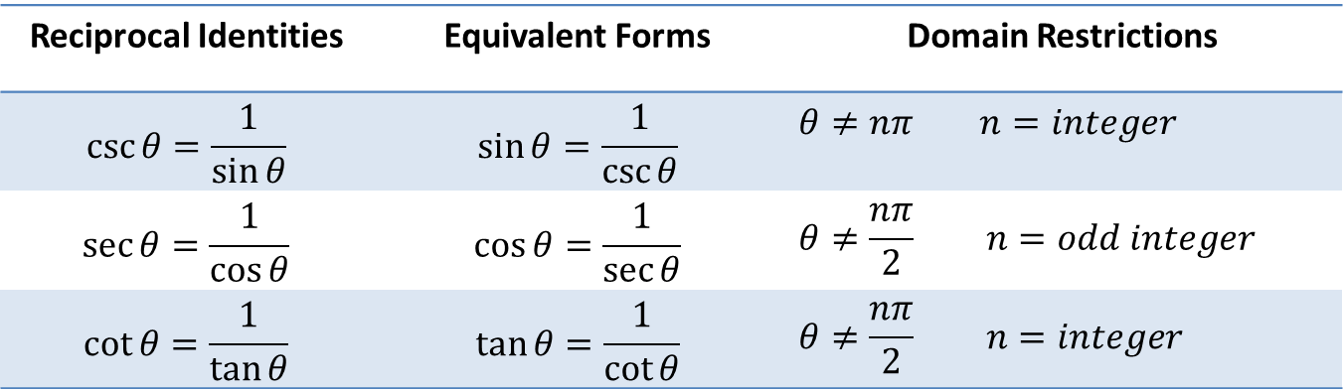
BASIC TRIGONOMETRIC IDENTITIES
Reciprocal Identities
Reciprocal Identities | Equivalent Forms | Domain Restrictions
$$\csc{θ=\frac{1}{\sin{θ}}}$$ | $$\sin{θ=\frac{1}{\csc{θ}}}$$ | $$θ≠nπ n=integer$$
$$\sec{θ=\frac{1}{\cos{θ}}}$$ | $$\cos{θ=\frac{1}{\sec{θ}}}$$ | $$θ≠\frac{nπ}{2} n=odd integer$$
$$\cot{θ=\frac{1}{\tan{θ}}}$$ | $$\tan{θ=\frac{1}{\cot{θ}}}$$ | $$θ≠\frac{nπ}{2} n=integer$$
Notes:
Week 5

Slide 5
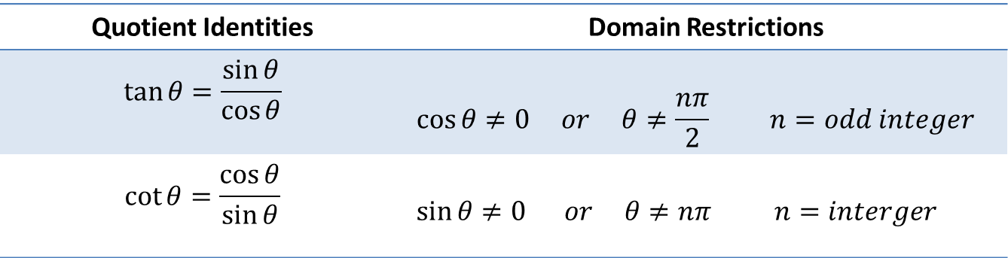
Quotient (or Ratio) Identities
Quotient Identities | Domain Restrictions
$$\tan{θ=\frac{\sin{θ}}{\cos{θ}}}$$ | $$\cos{θ≠0 or θ≠\frac{nπ}{2} n=odd integer}$$
$$\cot{θ=\frac{\cos{θ}}{\sin{θ}}}$$ | $$\sin{θ≠0 or θ≠nπ n=interger}$$
Notes:
Week 5

Slide 6
Pythagorean Identities
Negative Arguments Identities
$$\sin^{2} θ+\cos^{2}θ=1$$ | $$\tan^{2}θ+1=\sec^{2}θ$$ | $$1+\cot^{2}θ=\csc^{2}θ$$
$$sin \left(−θ\right)=−sin θ$$ | $$cos \left(−θ\right)=cos θ$$ | $$tan \left(−θ\right)=−tan θ$$
Notes:
Week 5

Slide 7
Guidelines for Verifying Trigonometric Identities
The following suggestions help guide the way to verifying trigonometric identities:
Start with the more complicated side of the equation.
Combine all sums and differences of fractions (quotients) into a single fraction (quotient).
Use basic trigonometric identities.
Use algebraic techniques to manipulate one side of the other side of the equation is achieved.
Sometimes it is helpful to convert all trigonometric functions into sines and cosines.
Note:
Trigonometric identities must be valid for all values of the independent variable for which the expressions in the equation are defined (domain of the equation).
Notes:
Week 5

Slide 8
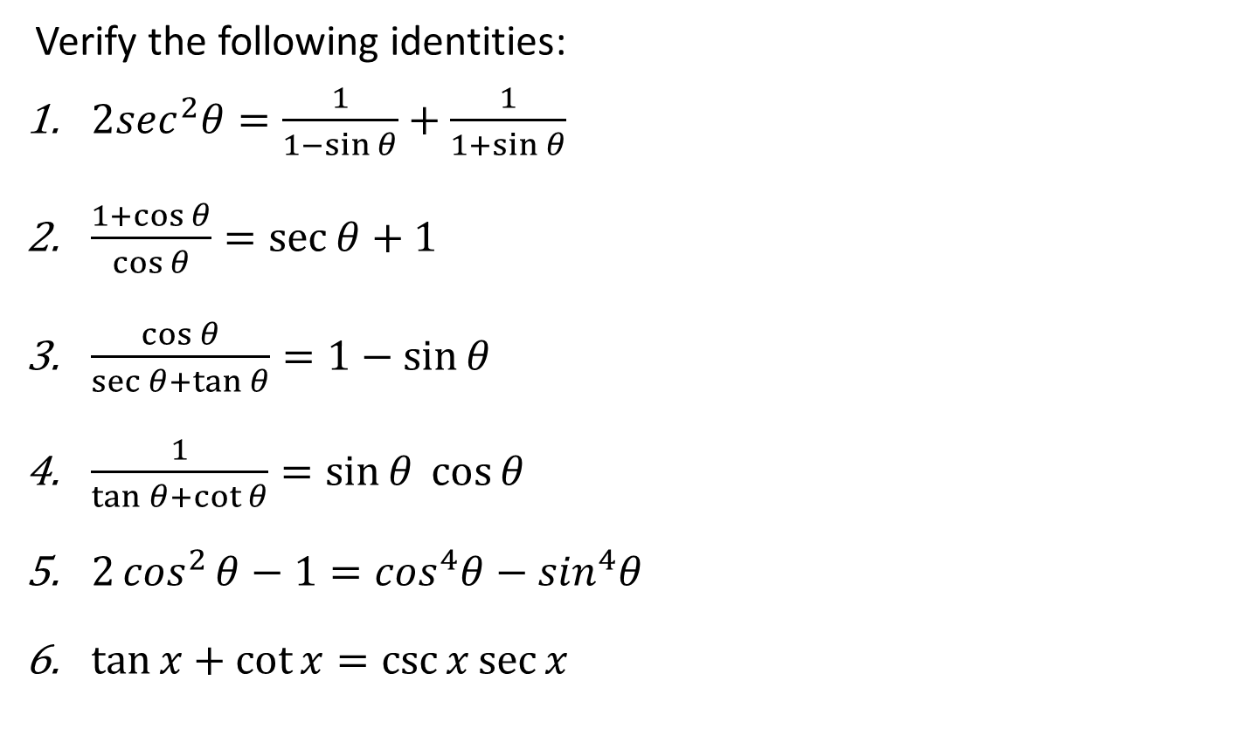
Examples
Verify the following identities:
$2\sec^{2}θ=\frac{1}{1−\sin{θ}}+\frac{1}{1+\sin{θ}}$
$\frac{1+\cos{θ}}{\cos{θ}}=\sec{θ+1}$
$\frac{\cos{θ}}{\sec{θ+\tan{θ}}}=1−\sin{θ}$
$\frac{1}{\tan{θ+\cot{θ}}}=\sin{θ\cos{θ}}$
$2\cos^{2}{θ−1=\cos^{4}θ}−\sin^{4}θ$
$\tan{x+\cot{x=\csc{x\sec{x}}}}$
Notes:
Week 5

Slide 9
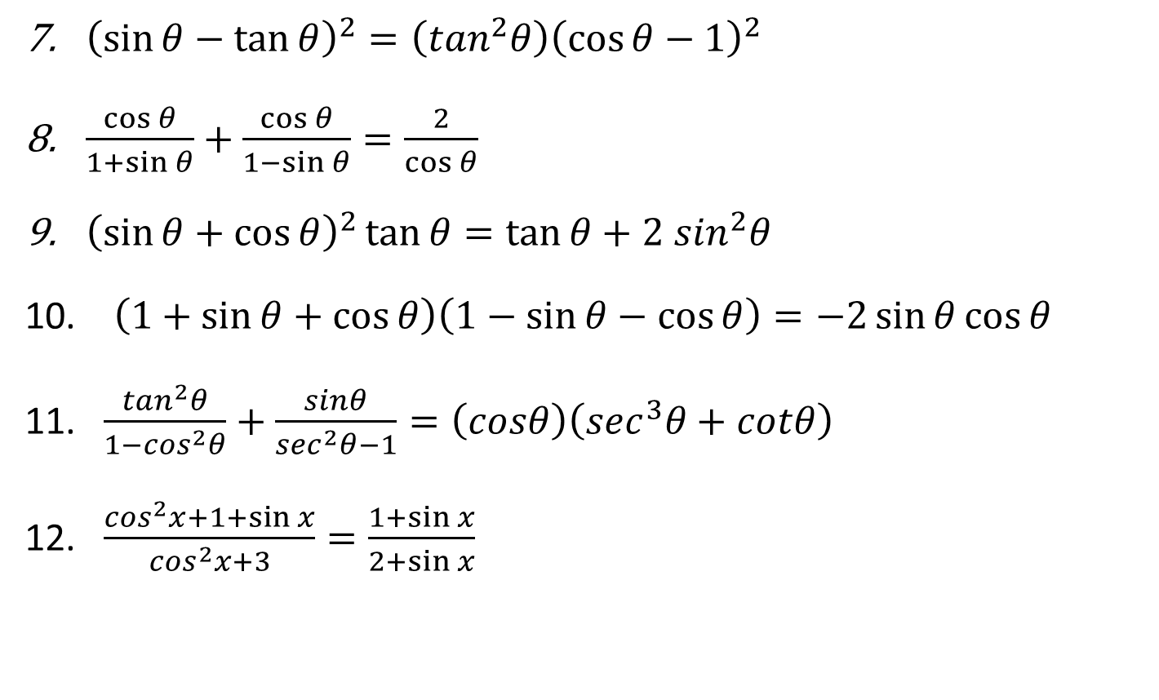
${\left(\sin{θ−\tan{θ}}\right)}^{2}=\left(\tan^{2}θ\right){\left(\cos{θ−1}\right)}^{2}$
$\frac{\cos{θ}}{1+\sin{θ}}+\frac{\cos{θ}}{1−\sin{θ}}=\frac{2}{\cos{θ}}$
${\left(\sin{θ+\cos{θ}}\right)}^{2}\tan{θ=\tan{θ+2 \sin^{2}θ}}$
$\left(1+\sin{θ+\cos{θ}}\right)\left(1−\sin{θ−\cos{θ}}\right)=−2\sin{θ\cos{θ}}$
$\frac{\tan^{2}θ}{1−\cos^{2}θ}+\frac{sinθ}{\sec^{2}θ−1}=\left(cosθ\right)\left(\sec^{3}θ+cotθ\right)$
$\frac{\cos^{2}x+1+\sin{x}}{\cos^{2}x+3}=\frac{1+\sin{x}}{2+\sin{x}}$
Notes:
Week 5

Slide 10
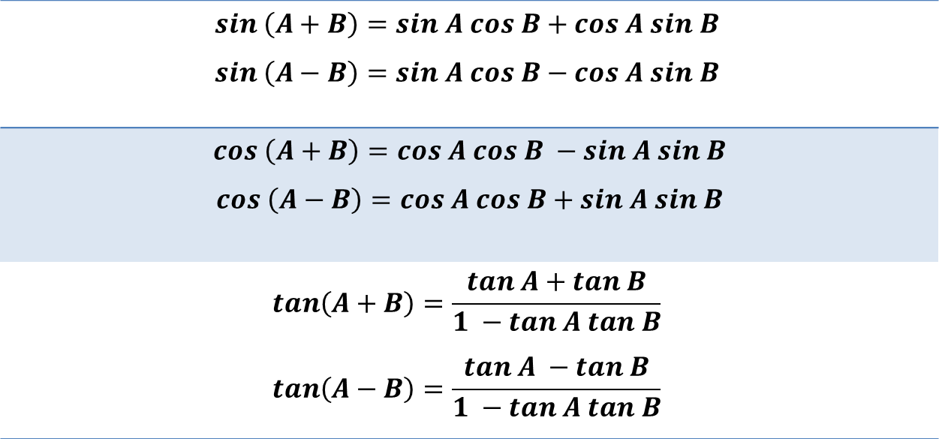
Sum and Difference Identities
$$sin \left(A+B\right)=sin A cos B+cos A sin B$$ $$sin \left(A−B\right)=sin A cos B−cos A sin B$$
$$cos \left(A+B\right)=cos A cos B −sin A sin B$$ $$cos \left(A−B\right)=cos A cos B+sin A sin B$$
$$tan\left(A+B\right)=\frac{tan A+tan B}{1 −tan A tan B}$$ $$tan\left(A−B\right)=\frac{tan A −tan B}{1 −tan A tan B}$$
Notes:
Week 5

Slide 11
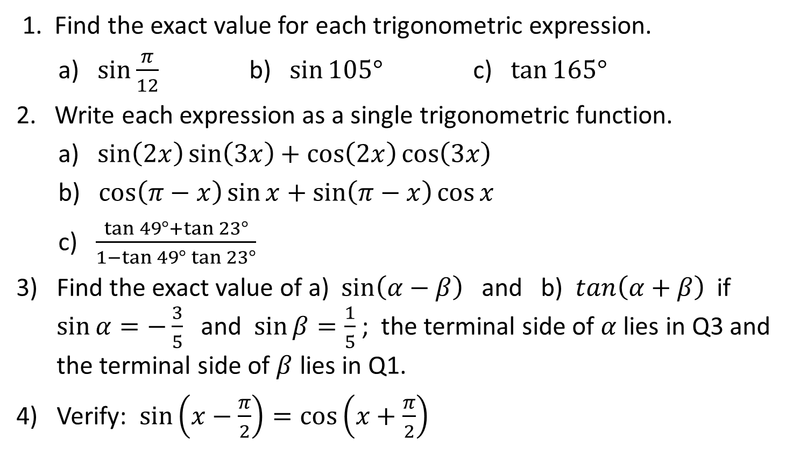
Examples
1. Find the exact value for each trigonometric expression.
a) $\sin{\frac{π}{12}}$ b) $\sin{105°}$ c) $\tan{165°}$
2. Write each expression as a single trigonometric function.
a) $\sin\left(2x\right)\sin\left(3x\right)+\cos\left(2x\right)\cos\left(3x\right)$
b) $\cos\left(π−x\right)\sin{x+\sin\left(π−x\right)\cos{x}}$
c) $\frac{\tan{49°+\tan{23°}}}{1−\tan{49°\tan{23°}}}$
Find the exact value of a) $\sin\left(α−β\right)$ and b) $tan\left(α+β\right)$ if $\sin{α=−\frac{3}{5} }$and $\sin{β=\frac{1}{5}}$ ; the terminal side of $α$ lies in Q3 and the terminal side of $β$ lies in Q1.
Verify: $\sin\left(x−\frac{π}{2}\right)=\cos\left(x+\frac{π}{2}\right)$
Notes:
Week 5

Slide 12
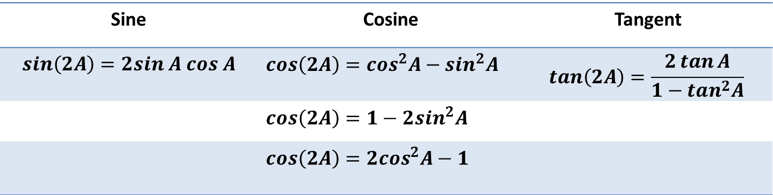
Double-Angle Identities
Sine | Cosine | Tangent
$$sin\left(2A\right)=2sin A cos A$$ | $$cos\left(2A\right)=\cos^{2}A−\sin^{2}A$$ | $$tan\left(2A\right)=\frac{2\tan{A}}{1−\tan^{2}A}$$
 | $$cos\left(2A\right)=1−2\sin^{2}A$$
 | $$cos\left(2A\right)=2\cos^{2}A−1$$
Notes:
Week 5

Slide 13
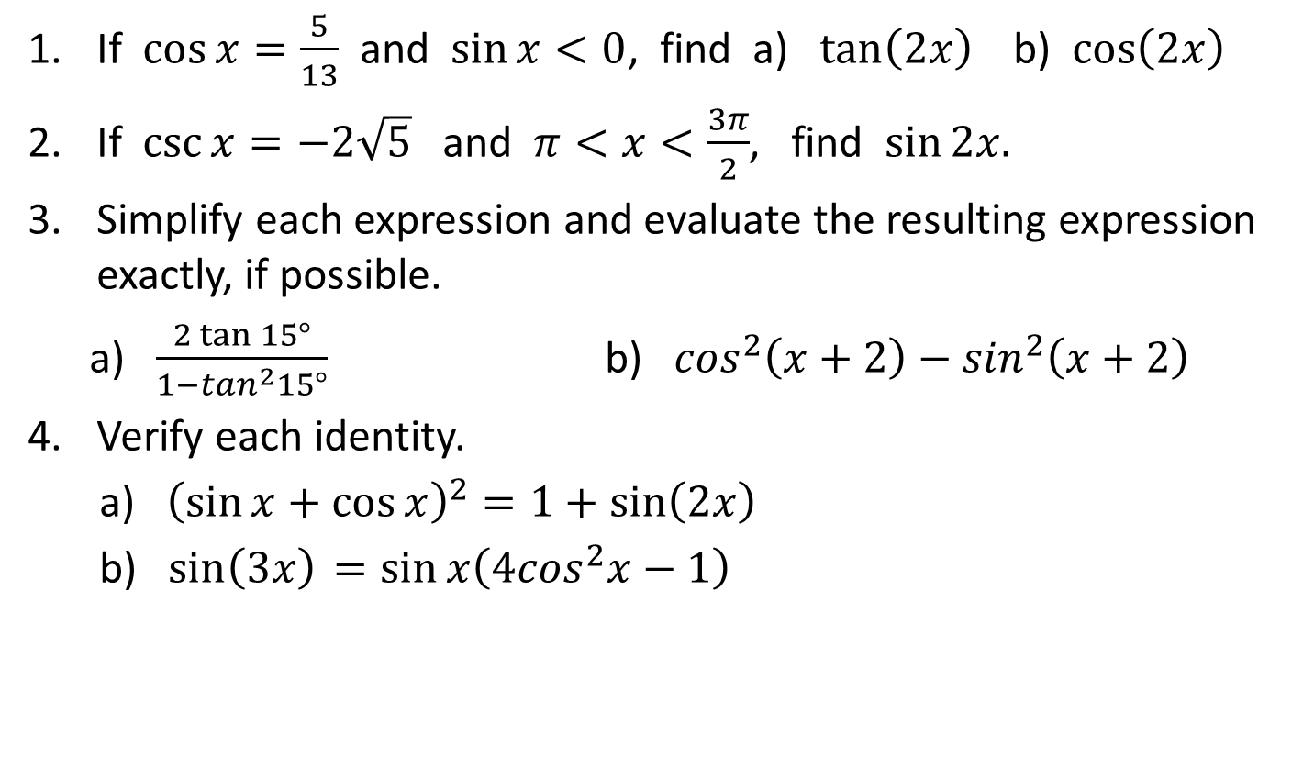
Examples
If $\cos{x=\frac{5}{13}}$ and $\sin{x<0}$, find a) $\tan\left(2x\right)$ b) $\cos\left(2x\right)$
If $\csc{x=−2\sqrt{5}}$ and $π<x<\frac{3π}{2}$, find $\sin{2x.}$
Simplify each expression and evaluate the resulting expression exactly, if possible.
a) $\frac{2\tan{15°}}{1−\tan^{2}15°}$ b) $\cos^{2}\left(x+2\right)−\sin^{2}\left(x+2\right)$
Verify each identity.
a) ${\left(\sin{x+\cos{x}}\right)}^{2}=1+\sin\left(2x\right)$
b) $sin\left(3x\right){ =\sin{x\left(4\cos^{2}x−1\right)} }$
Notes:
Week 5

Slide 14
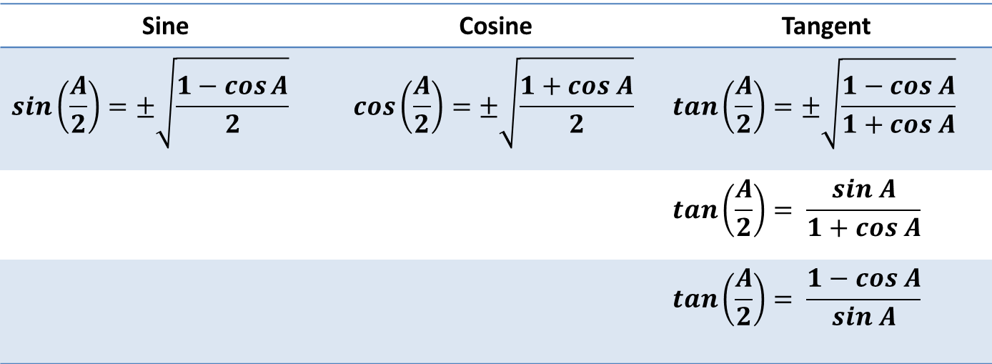
Half-Angle Identities
Sine | Cosine | Tangent
$$sin\left(\frac{A}{2}\right)=±\sqrt{\frac{1−\cos{A}}{2}}$$ | $$cos\left(\frac{A}{2}\right)=±\sqrt{\frac{1+cos A}{2}}$$ | $$tan\left(\frac{A}{2}\right)=±\sqrt{\frac{1−cos A}{1+cos A}}$$
 |  | $$tan\left(\frac{A}{2}\right)= \frac{sin A}{1+cos A}$$
 |  | $$tan\left(\frac{A}{2}\right)= \frac{1−cos A}{sin A}$$
Notes:
Week 5

Slide 15
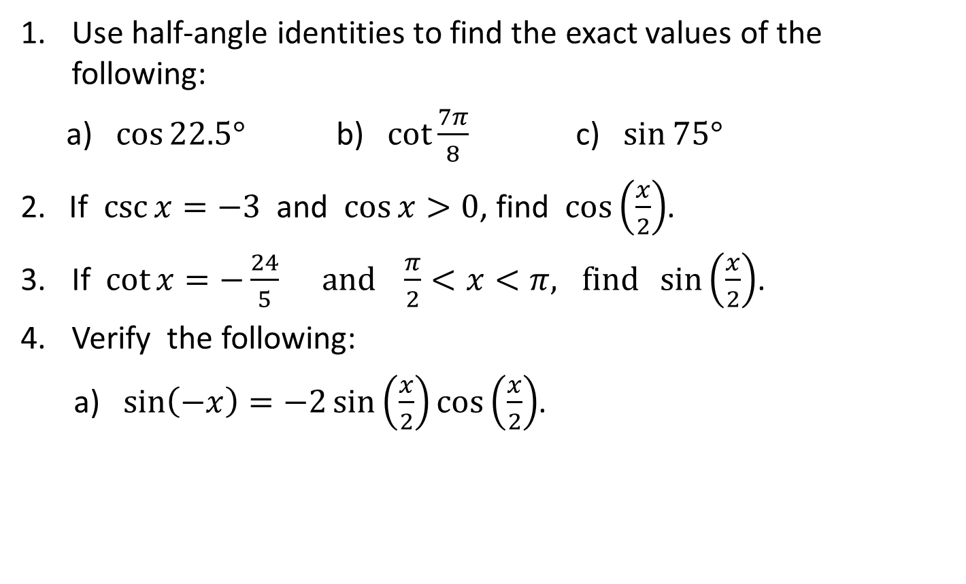
Examples
Use half-angle identities to find the exact values of the following:
a) $\cos{22.5°}$ b) $\cot{\frac{7π}{8}}$ c) $\sin{75°}$
2. If $\csc{x=−3}$ and $\cos{x>0}$, find $\cos\left(\frac{x}{2}\right)$.
If $\cot{x=−\frac{24}{5}} and \frac{π}{2}<x<π, find \sin\left(\frac{x}{2}\right)$.
Verify the following:
a) $\sin\left(−x\right)=−2\sin\left(\frac{x}{2}\right)\cos\left(\frac{x}{2}\right)$.
Notes:
Week 5

Slide 16
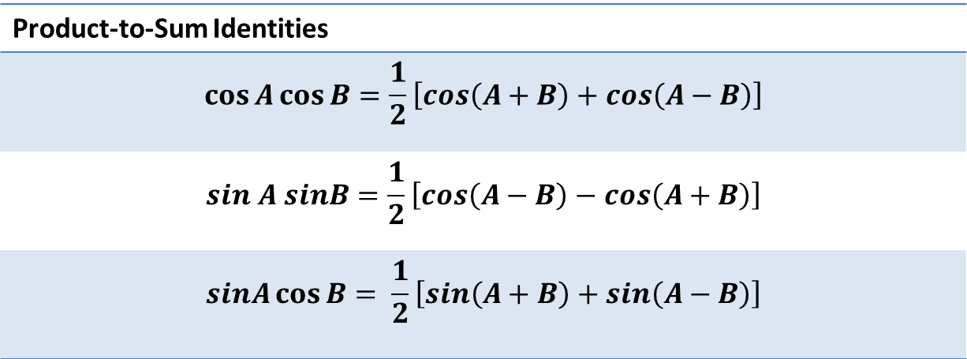
Product-to-Sum and Sum-to-Prroduct Identities
Product-to-Sum Identities
$$\cos{A\cos{B=\frac{1}{2}\left[cos\left(A+B\right)+cos\left(A−B\right)\right]}}$$
$$sin A sinB=\frac{1}{2}\left[cos\left(A−B\right)−cos\left(A+B\right)\right]$$
$$sinA\cos{B= \frac{1}{2}\left[sin\left(A+B\right)+sin\left(A−B\right)\right]}$$
Notes:
Week 5

Slide 17
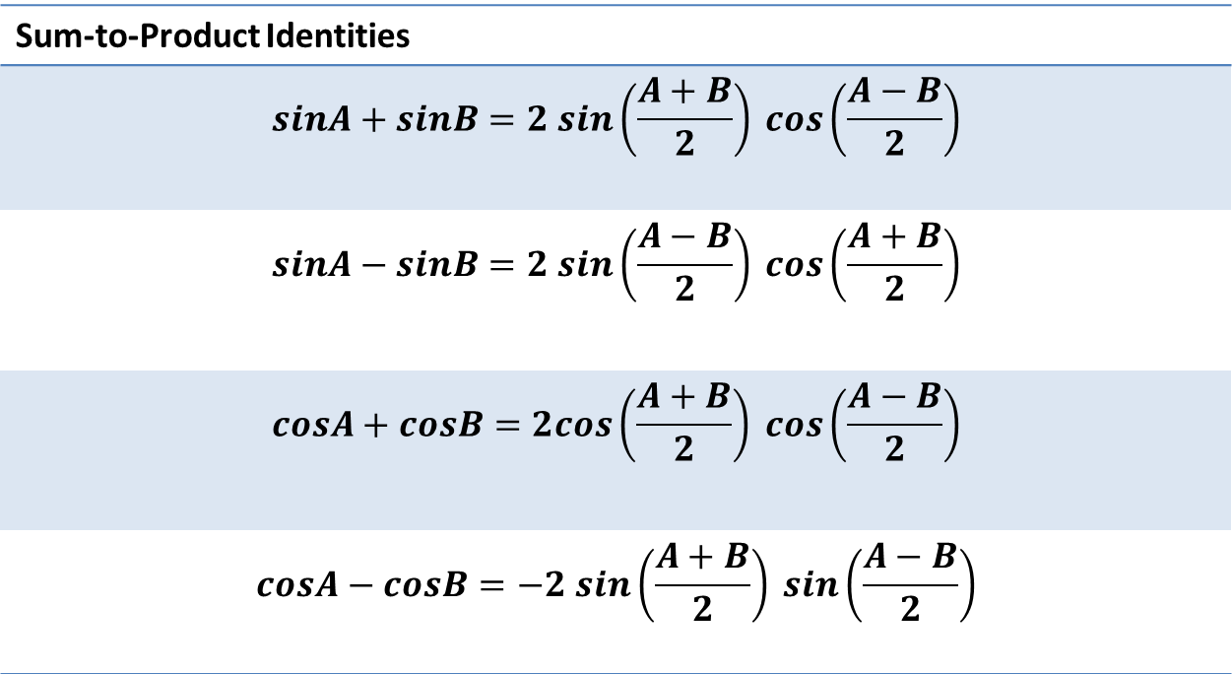
Product-to-Sum and Sum-to-Product Identities
Sum-to-Product Identities
$$sinA+sinB=2 sin\left(\frac{A+B}{2}\right) cos\left(\frac{A−B}{2}\right)$$
$$sinA−sinB=2 sin\left(\frac{A−B}{2}\right) cos\left(\frac{A+B}{2}\right)$$
$$cosA+cosB=2cos\left(\frac{A+B}{2}\right) cos\left(\frac{A−B}{2}\right)$$
$$cosA−cosB=−2 sin\left(\frac{A+B}{2}\right) sin\left(\frac{A−B}{2}\right)$$
Notes:
Week 5

Slide 18
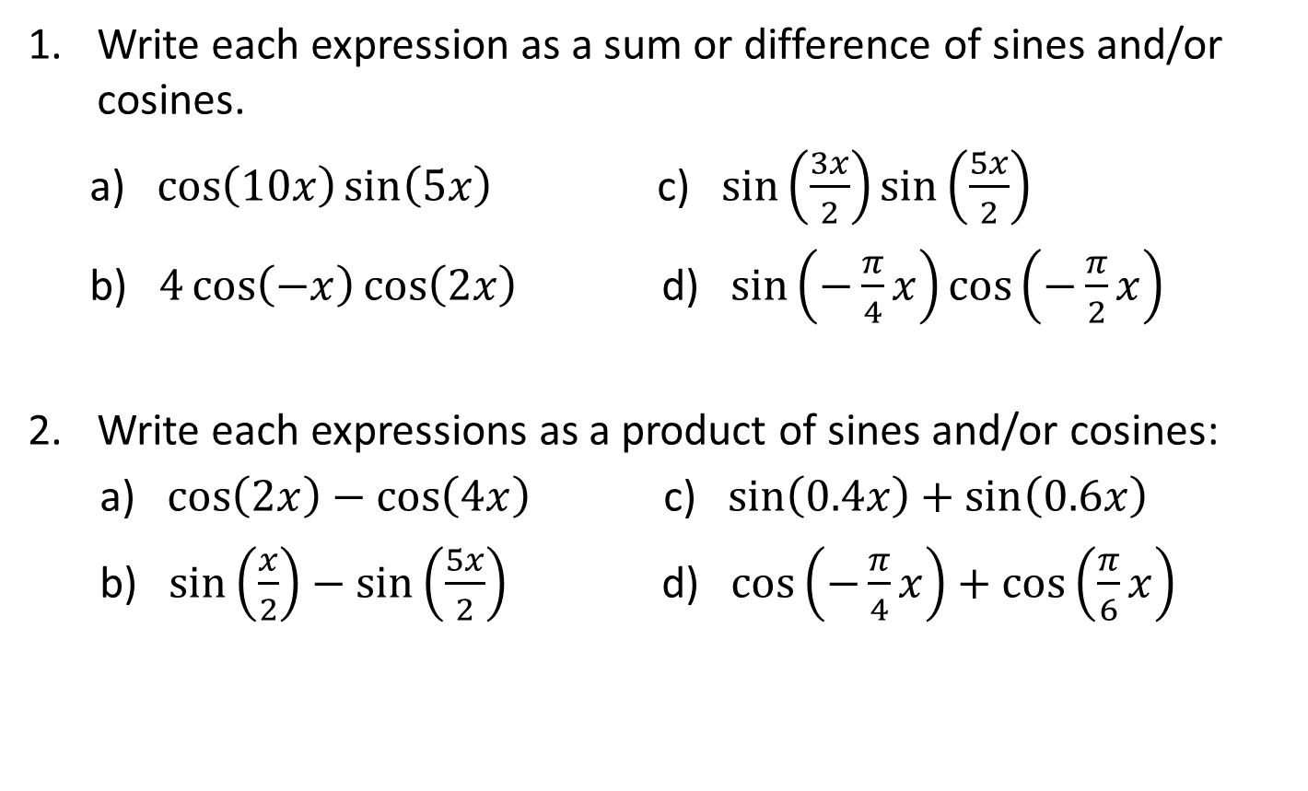
Examples
Write each expression as a sum or difference of sines and/or cosines.
a) $\cos\left(10x\right)\sin\left(5x\right)$ c) $\sin\left(\frac{3x}{2}\right)\sin\left(\frac{5x}{2}\right)$
b) $4\cos\left(−x\right)\cos\left(2x\right)$ d) $\sin\left(−\frac{π}{4}x\right)\cos\left(−\frac{π}{2}x\right)$
Write each expressions as a product of sines and/or cosines:
a) $\cos\left(2x\right)−\cos\left(4x\right)$ c) $\sin\left(0.4x\right)+\sin\left(0.6x\right)$
b) $\sin\left(\frac{x}{2}\right)−\sin\left(\frac{5x}{2}\right)$ d) $\cos\left(−\frac{π}{4}x\right)+\cos\left(\frac{π}{6}x\right)$
Notes:
Week 5

Slide 19
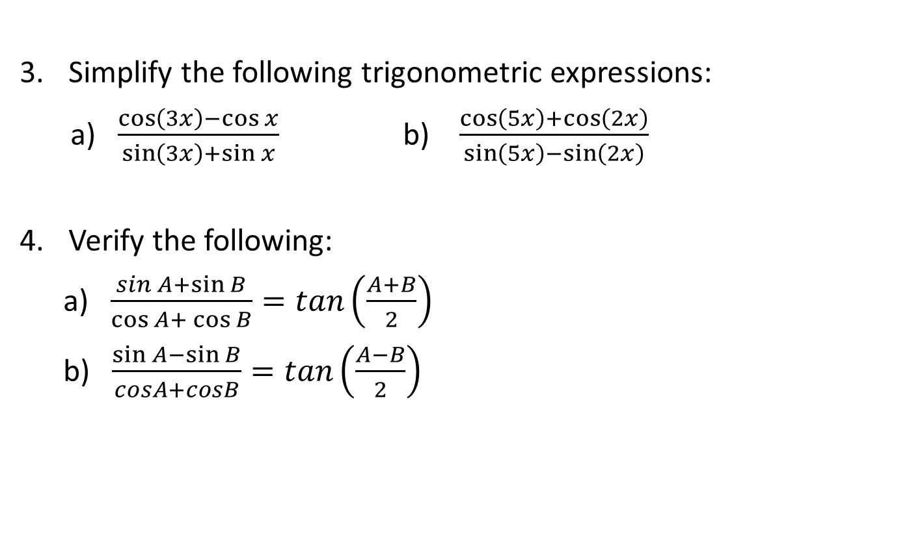
Examples
Simplify the following trigonometric expressions:
a) $\frac{\cos\left(3x\right)−\cos{x}}{\sin\left(3x\right)+\sin{x}}$ b) $\frac{\cos\left(5x\right)+\cos\left(2x\right)}{\sin\left(5x\right)−\sin\left(2x\right)}$
Verify the following:
a) $\frac{sin A+\sin{B}}{\cos{A+}\cos{B}}=tan\left(\frac{A+B}{2}\right)$
b) $\frac{\sin{A−\sin{B}}}{cosA+cosB}=tan\left(\frac{A−B}{2}\right)$
Notes:
Week 5

Slide 20
References
Algebra and Trigonometry by Cynthia Young
Trigonometry by Jerome Hayden and Bettye Hall
Trigonometry by Academe/Scott, Foresman
Plane and Spherical Trigonometry by Paul Rider
Notes:
Week 5

